Slide 1



ML/DL for Everyone with
Lecture 14: Sequence to Sequence
Sung Kim <hunkim+ml@gmail.com> HKUST
Code: https://github.com/hunkim/PyTorchZeroToAll
Slides: http://bit.ly/PyTorchZeroAll

Slide 2

Call for Comments
Please feel free to add comments directly on these slides.
Other slides: http://bit.ly/PyTorchZeroAll
Picture from http://www.tssablog.org/archives/3280

Slide 3
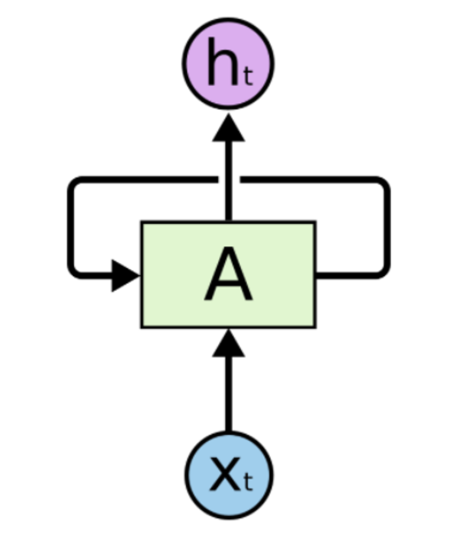
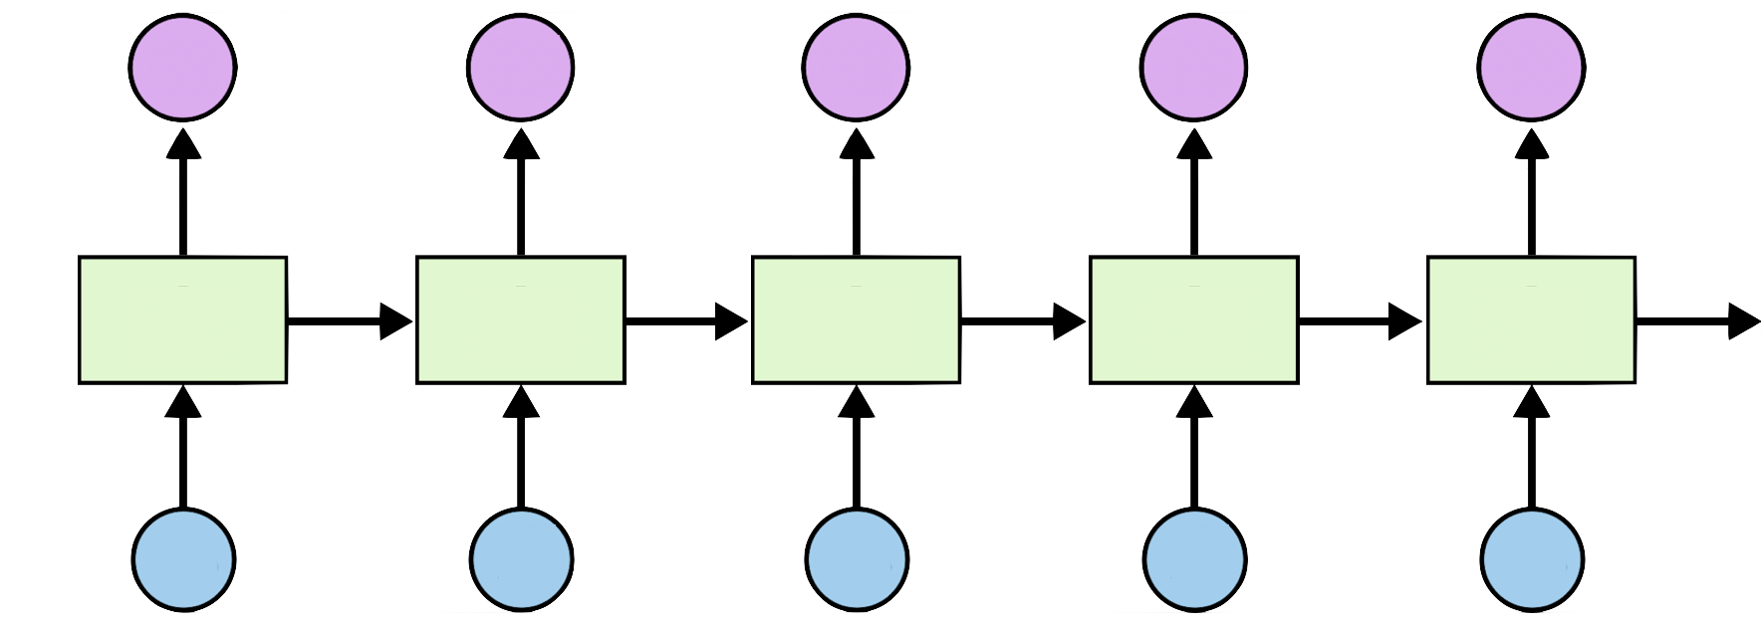
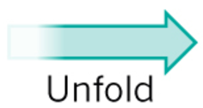
DNN, CNN, RNN
http://practicalquant.blogspot.hk/2013/10/deep-learning-oral-traditions.html

Slide 4
RNN
Linear
P(y=0)
P(y=1)
…
P(y=n)
CrossEnropy

Slide 5
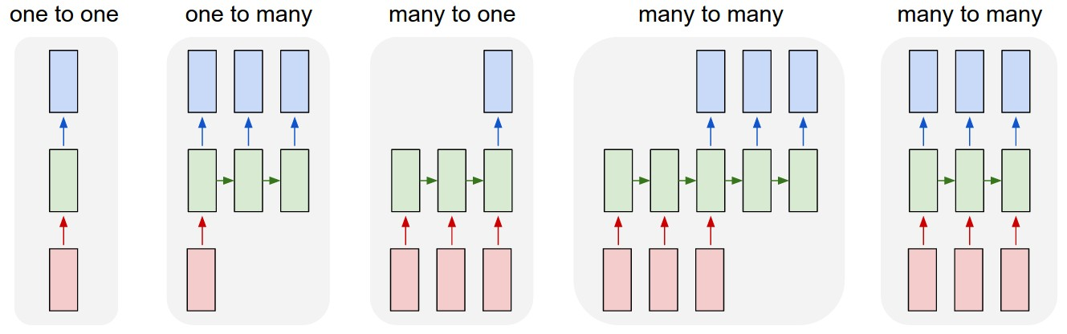
RNN Applications
http://karpathy.github.io/2015/05/21/rnn-effectiveness/

Slide 6
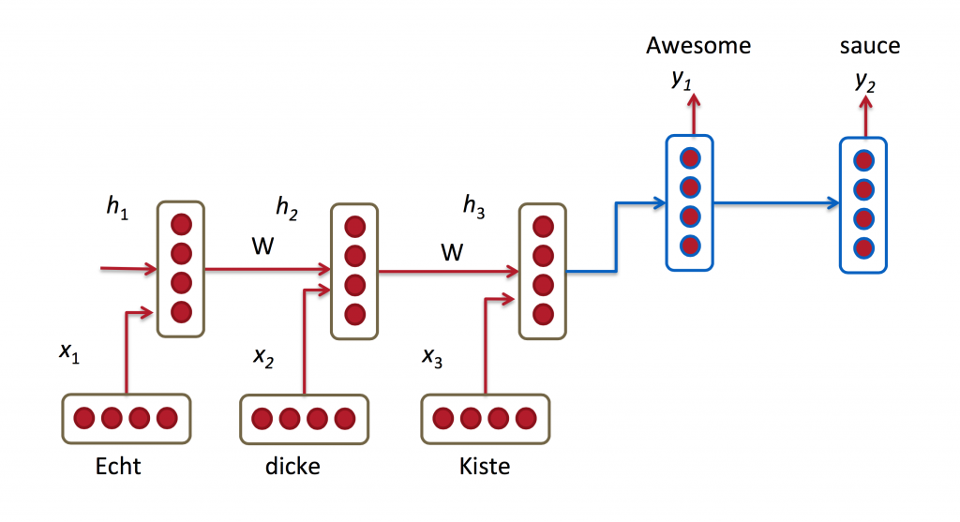
Sequence to Sequence
http://www.wildml.com/2016/01/attention-and-memory-in-deep-learning-and-nlp/

Slide 7
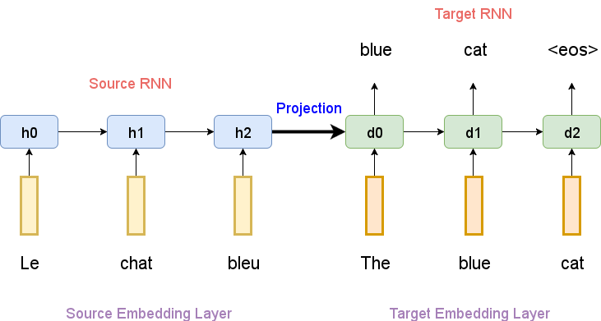
Lecture (TBA)
Implement Learning Phrase Representations using RNN Encoder-Decoder for Statistical Machine Translation: https://arxiv.org/abs/1406.1078
Image source: https://github.com/MaximumEntropy/Seq2Seq-PyTorch

Slide 8
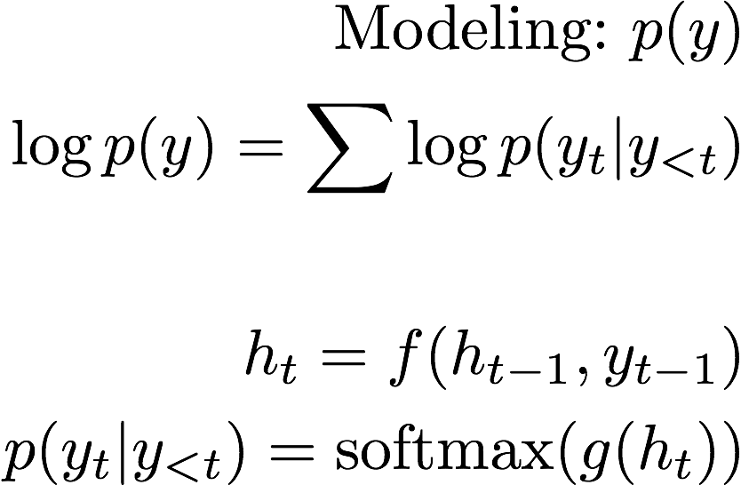
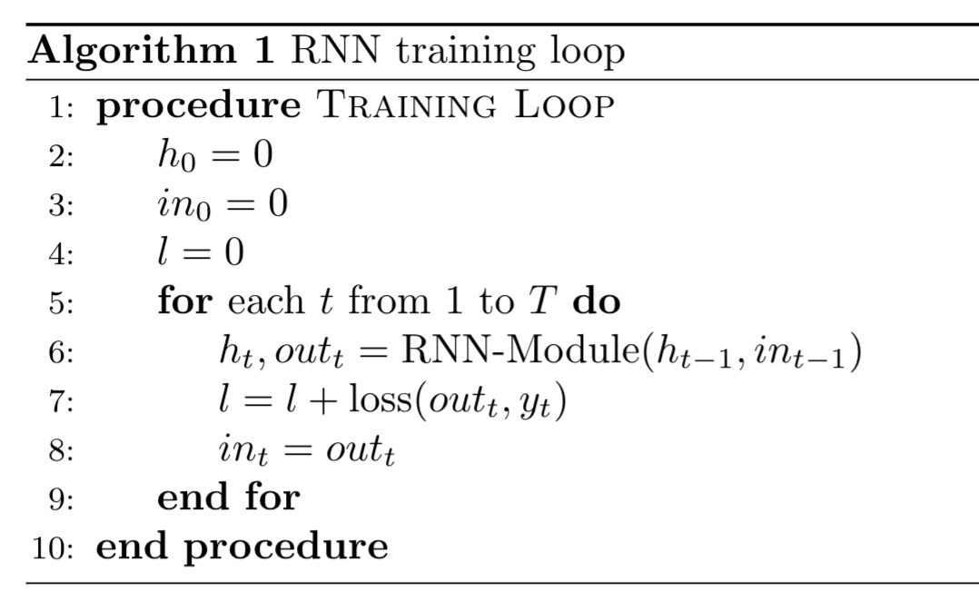
Summary: RNN (WIP)
y₁
y_{t}
h_{t}
y_{t-1}
loss = 0
hidden = model.init_hidden()
Input = one_hot(labels[0])
for label in labels:
hidden, output = model(hidden, input)
loss += criterion(output, label)
input = one_hot(output.max(1))
loss.backward()
optimizer.step()
Notes:
\textrm{Goal:}~p(y) \\
\log p(y)=\sum(\log p(y_t|y_{<t}) \\\\
h_t = f(h_{t-1}, y_{t-1}) \\
p(y_t|y_{<t}) = \textrm{softmax} (g(h_t))
------------
v

Slide 9
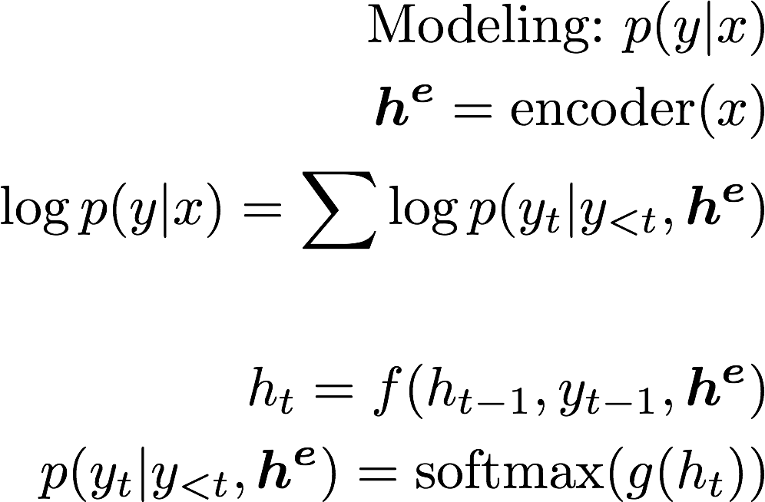
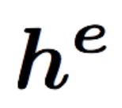
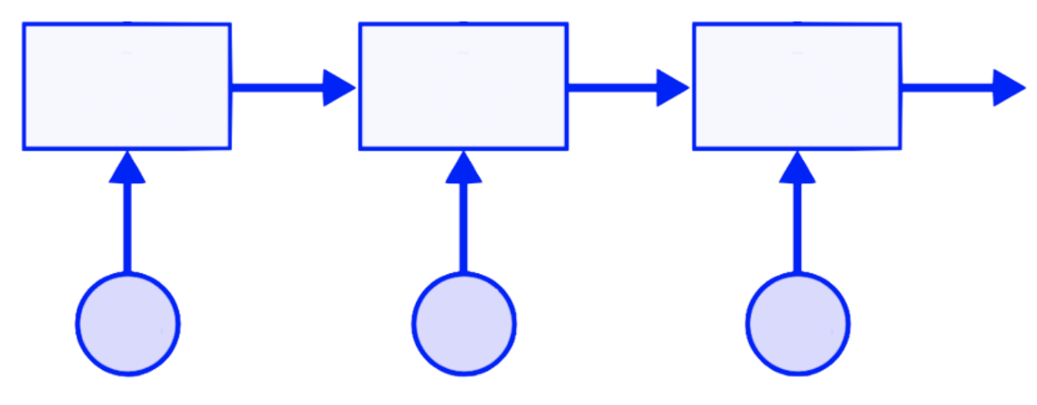
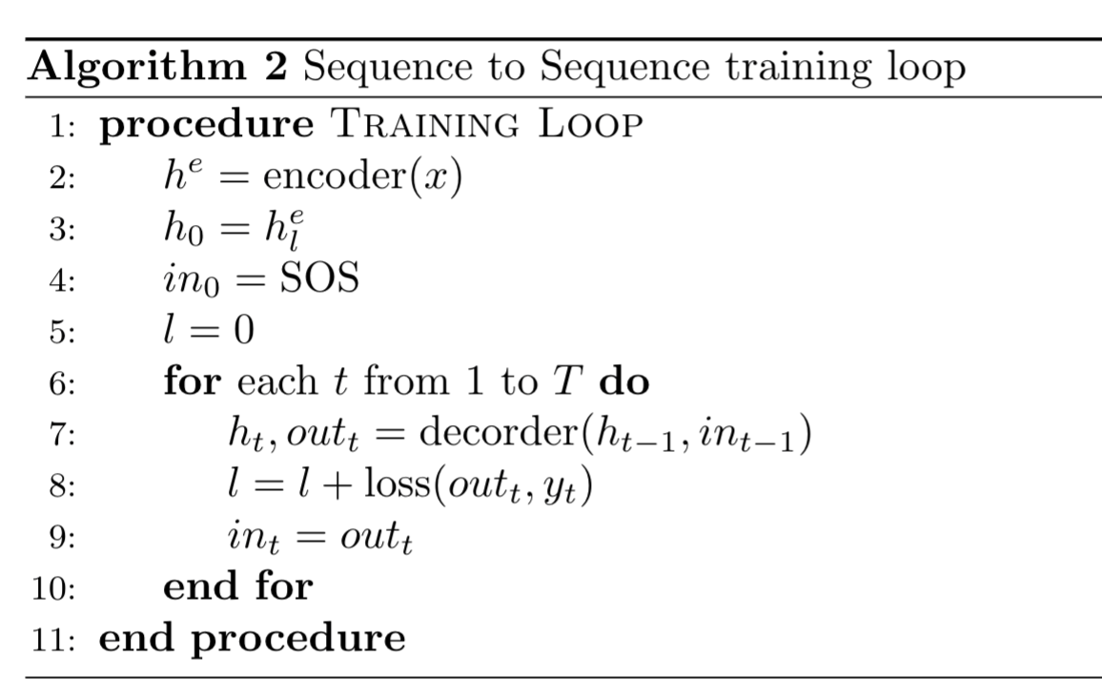
Summary: S2S (WIP)
y₁
y_{t}
h_{t}
x_{l}
y_{t-1}
loss = 0
hidden = encoder(x)
input = SOS
for label in labels:
hidden, output = model(hidden, input)
loss += criterion(output, label)
input = one_hot(output.max(1))
loss.backward()
optimizer.step()
Notes:
\textrm{Modeling:}~p(y|x) \\
\boldsymbol{h^e}=\textrm{encoder}(x)\\
\log p(y|x)=\sum\log p(y_t|y_{<t}, \boldsymbol{h^e}) \\\\
h_t = f(h_{t-1}, y_{t-1}, \boldsymbol{h^e}) \\
p(y_t|y_{<t}, \boldsymbol{h^e}) = \textrm{softmax} (g(h_t))
------------
v

Slide 10
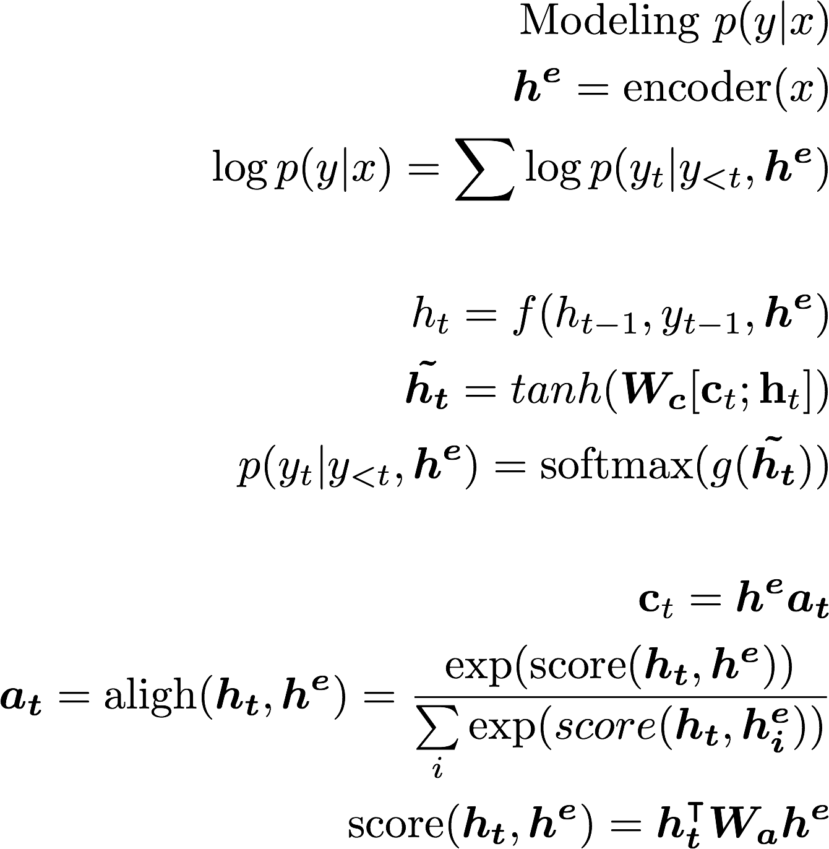
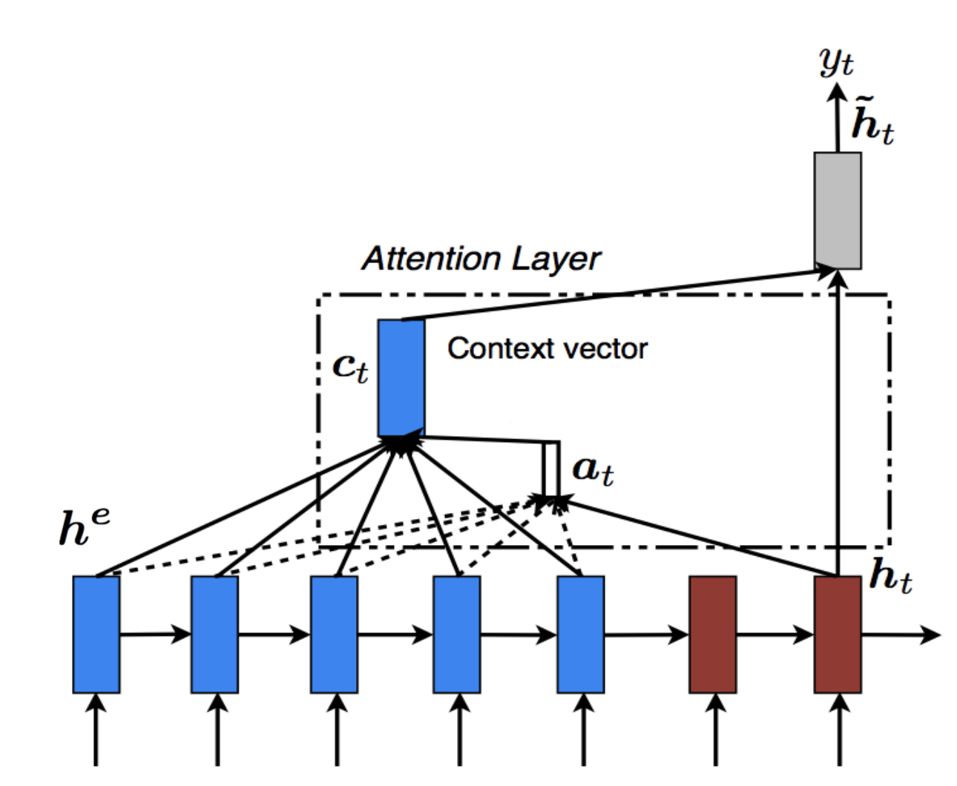
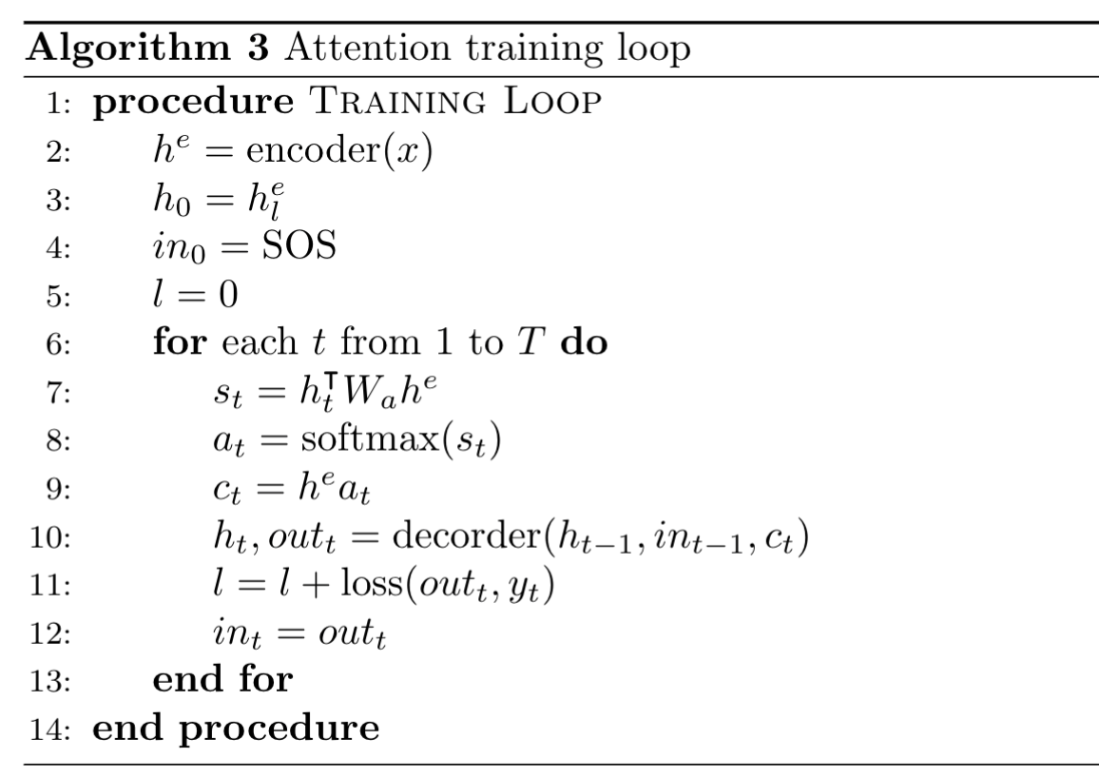
Summary: Attention (WIP)
Globally aligned
weights
Effective Approaches to Attention-based Neural Machine Translation (emnlp15)
Notes:
\textrm{Modeling}~p(y|x) \\
\boldsymbol{h^e}=\textrm{encoder}(x)\\
\log p(y|x)=\sum\log p(y_t|y_{<t}, \boldsymbol{h^e}) \\\\
h_t = f(h_{t-1}, y_{t-1}, \boldsymbol{h^e}) \\
\boldsymbol{\tilde{h_t}}=tanh(\boldsymbol{W_c}[\textbf{c}_t;\textbf{h}_t])\\
p(y_t|y_{<t}, \boldsymbol{h^e}) = \textrm{softmax} (g(\boldsymbol{\tilde{h_t}}))
\\\\
\textbf{c}_t = \boldsymbol{h^e a_t}\\
\boldsymbol{a_{t}} = \textrm{aligh}(\boldsymbol{h_t},\boldsymbol{h^e})=
\frac{\exp(\textrm{score}(\boldsymbol{h_t},\boldsymbol{h^e}))}
{\sum\limits_{i}\exp(score(\boldsymbol{h_t},\boldsymbol{h^e_i}))}\\
\textrm{score}(\boldsymbol{h_t},\boldsymbol{h^e}) = \boldsymbol{h_t^\intercal W_a h^e}
\\\\

Slide 11
References
Sequence to Sequence
Sequence to Sequence models: https://github.com/MaximumEntropy/Seq2Seq-PyTorch
Learning Phrase Representations using RNN Encoder-Decoder for Statistical Machine Translation: https://arxiv.org/abs/1406.1078
Attention Models
Attention and Augmented Recurrent Neural Networks https://distill.pub/2016/augmented-rnns/
Neural Machine Translation by Jointly Learning to Align and Translate: https://arxiv.org/abs/1409.0473
Effective Approaches to Attention-based Neural Machine Translation: https://arxiv.org/abs/1508.04025

Slide 12
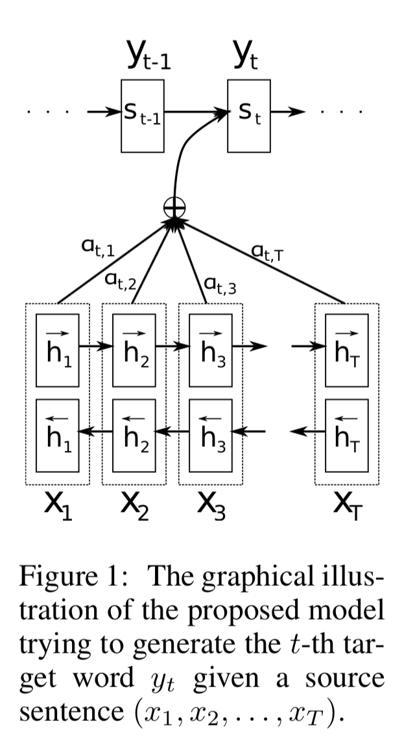
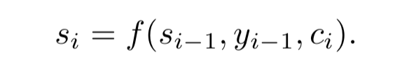
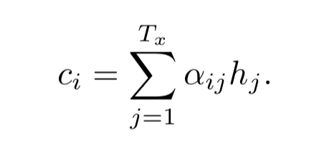
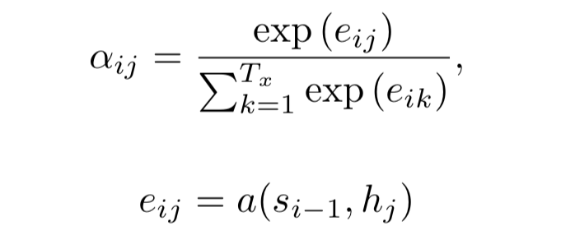
Exercise 13-1
Implement Neural Machine Translation by Jointly Learning to Align and Translate: https://arxiv.org/abs/1409.0473
C_{t}
https://arxiv.org/abs/1409.0473

Slide 13
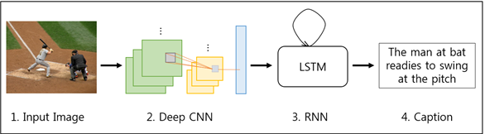
Exercise 13-2
Implement A Neural Image Caption Generator: https://arxiv.org/abs/1411.4555
http://brain.kaist.ac.kr/research.html

Slide 14

If you’ve got this far, you did Good job!
Congratulations!!
Interested in DL/ML related PHD, Postdoc at HKUST
and/or internship, residency, research fellows at LINE/NAVER?
Please email your exercises (Lectures 10 to 13) and CV to
hunkim+jobs@gmail.com.

Slide 15


Lecture 14:
NSML,
Smartest ML Platform

